Slide 1
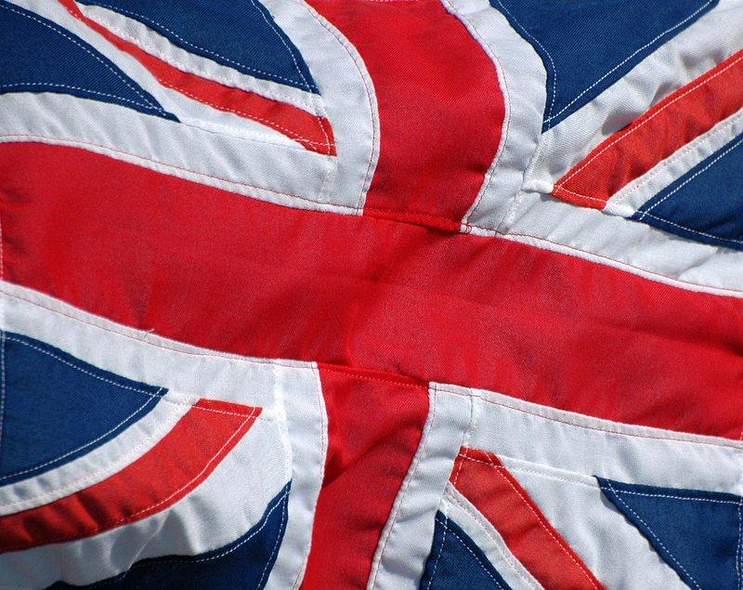
United Kingdom
Remy Perks

Slide 2
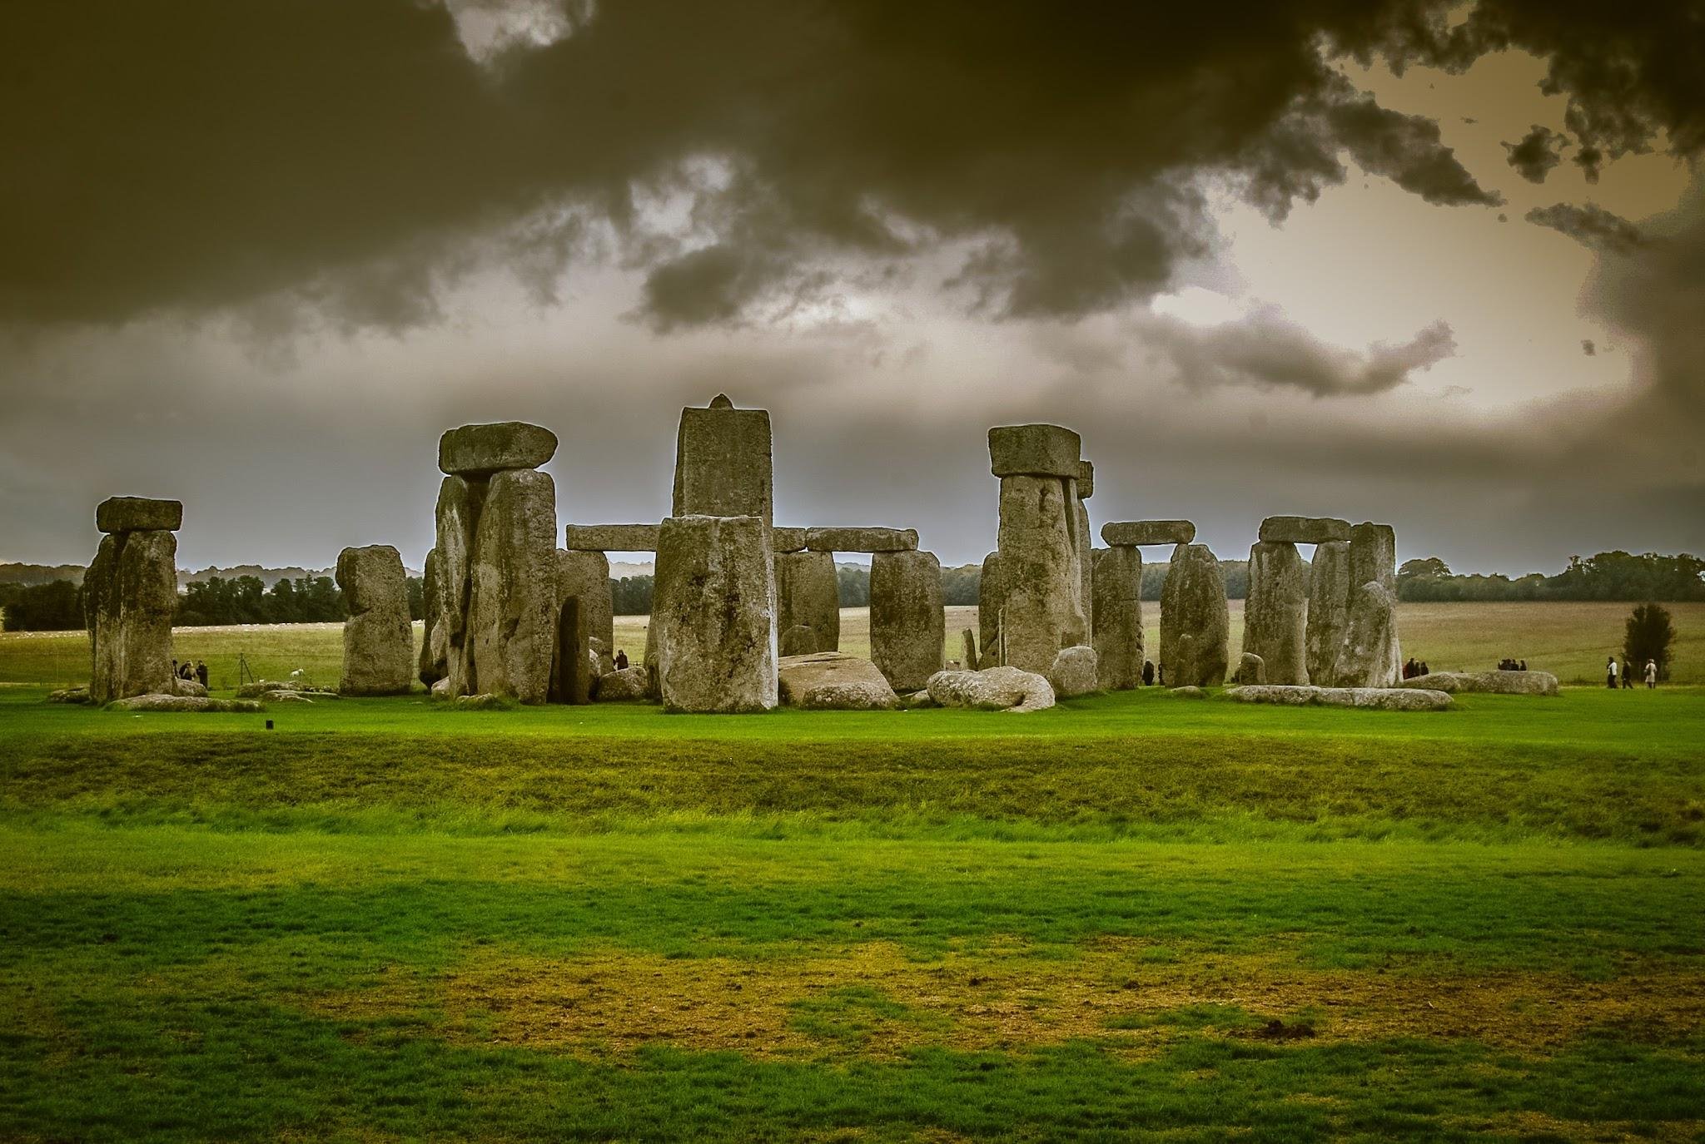
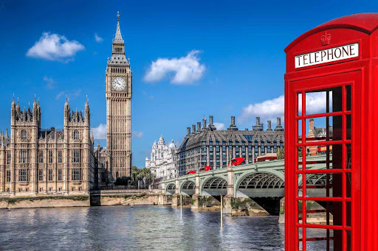
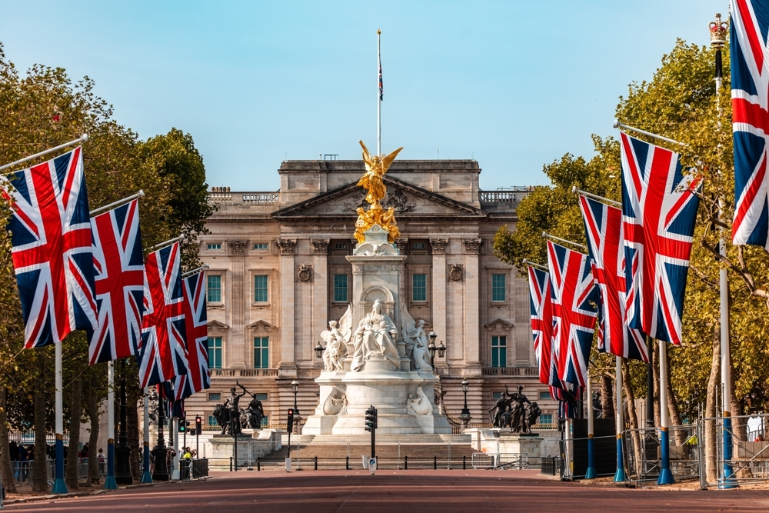
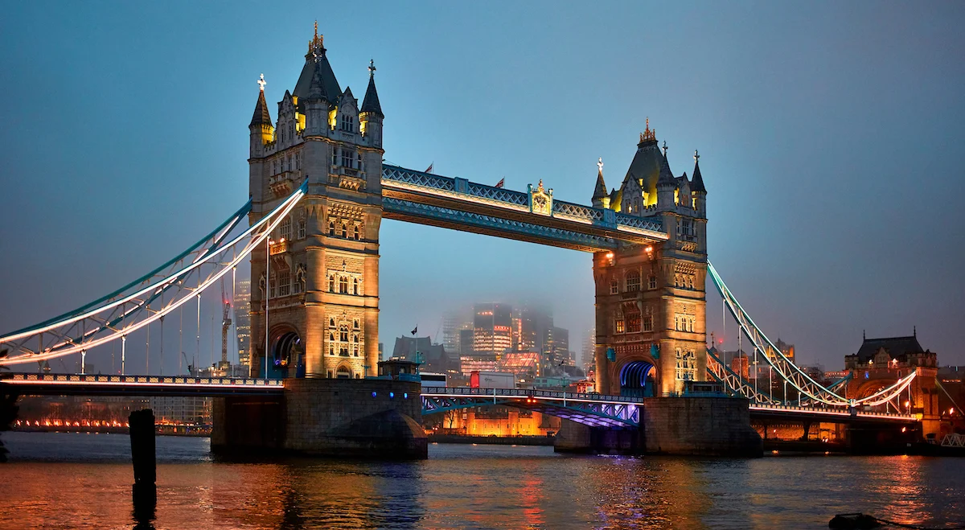
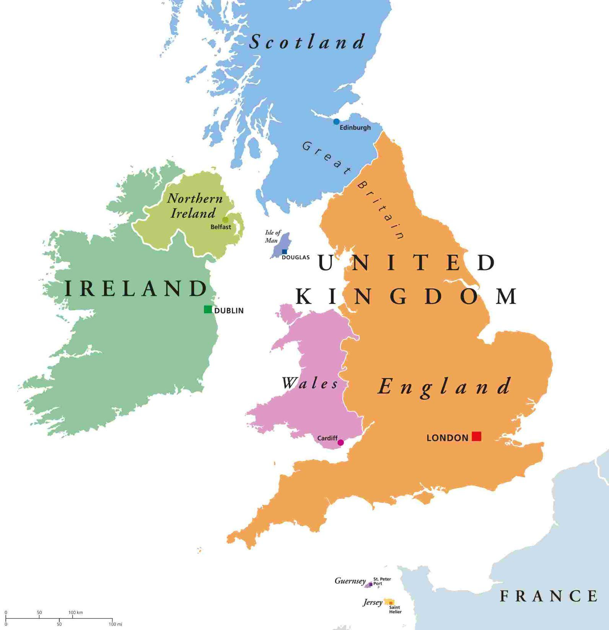
The Background And history of The United Kingdom
The United Kingdom is located in northwestern coast in Europe. The UK has 69 to 70 million people in thy country. The UK is country that is multicultural. The United Kingdom became a country in 1801. But they also were in the medieval times in 1066.

Slide 3
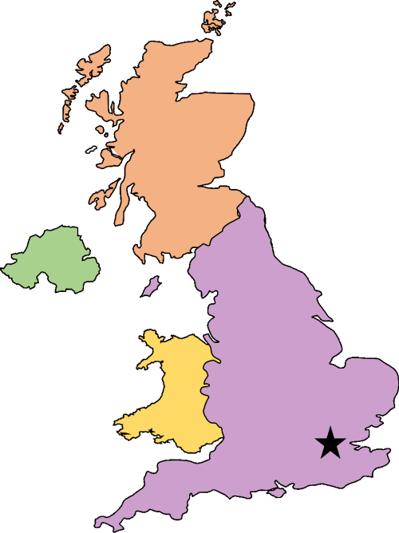





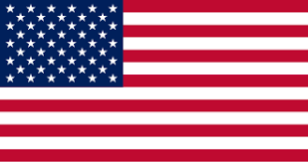

Sēo woruldlīce sprǣc on þǣm ānlǣhtan rīce
(“The worldly discussion in the united kingdom” Its old English)
The UK is having a huge problem with Immigration policies. The UK didn’t want people from Afghanistan, Cameroon, Myanmar, and Sudan, to buy tickets to go to the UK and ask to be refugees. So the UK had made a Visa break. Which is like saying “No more planes that are going to the UK from those countries!”
GO BACK!!!!
Sheesh! Dad’s rude.
YEAH! They had an argument for like 100 years!
👉
👎
I know. Hey! Remember when Mom (France) had so many arguments with dad, before we were born?

Slide 4
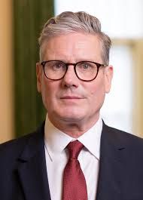
The Countries response.

